Slide 1
Introduction to GIT
15-OCT 2019

Slide 2
Agenda
VCS (Version control systems)
What is GIT ?
GIT branching
GIT most common commands
An example scenario

Slide 3
Version control systems (VCS)
Easily management collaboration on a project by avoiding frustration of swapping files.
Ability to have unlimited number of developers working on the same code base.
Easily revert back your files if something happened.

Slide 4
VCS (cont’d)
There are two main categories of version control system.
Centralized version control systems
Distributed version control systems

Slide 5
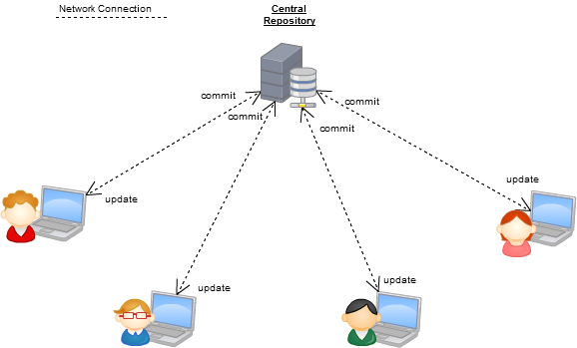
Centralized VCS
SVN
CVS
Perforce

Slide 6
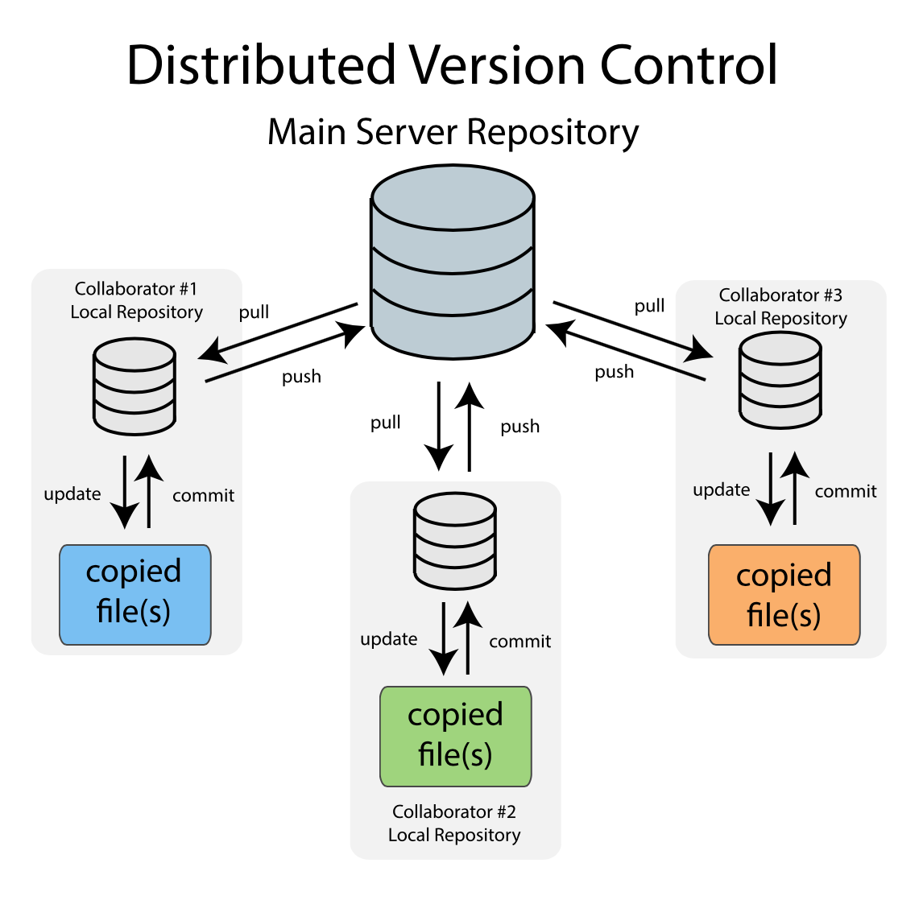
Distributed VCS
GIT
Mercurial

Slide 7
What is GIT?
Notes:
Linus Torvalds

Slide 8
What is GIT?
GIT is free and open source distributed system with the emphasis on speed and data integrity.
No centralized connectivity is needed.
Powerful and cheap branching with easy to merge.
Losing work in your project is very very hard.

Slide 9
.git directory structure

Slide 10
Directory structure
.git
HEAD/ (A pointer to your current branch)
config/ ( contains all configuration preferences)
description/(description of your project )
Index/ (is used as staging area between working directory and repo)
logs/ (keeps records to changes that are made in ref) objects/ (all data are stored here: commits, trees and tags )
hooks/ (shell scripts that are invoked after executing a command)
refs/ (holds your local branch remote branch and tags)

Slide 11
How to use GIT?

Slide 12
usage: git [OPTIONS] COMMAND [ARGS]
The most commonly used git commands are:
add: Add file contents to the index
commit: Record changes to the repository
diff: Show changes between commits, commit
git help <command>
https://git-scm.com/downloads

Slide 13
Introduce yourself to git:
git config --global user.name "Emanuele Olivetti"
git config --global user.email "olivetti@fbk.eu"

Slide 14
Git can be used locally
First step towards a shared project.
Backup.
To keep the memory of your work.

Slide 15
GIT init
**Local commands. Only for single user

Slide 16
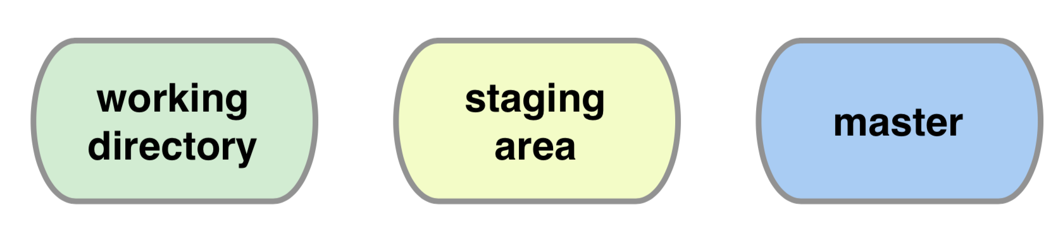
git init
Creates an empty git repository.
Creates the git directory: .git/
Note: it is safe. It does not change your pre-existing files.

Slide 17
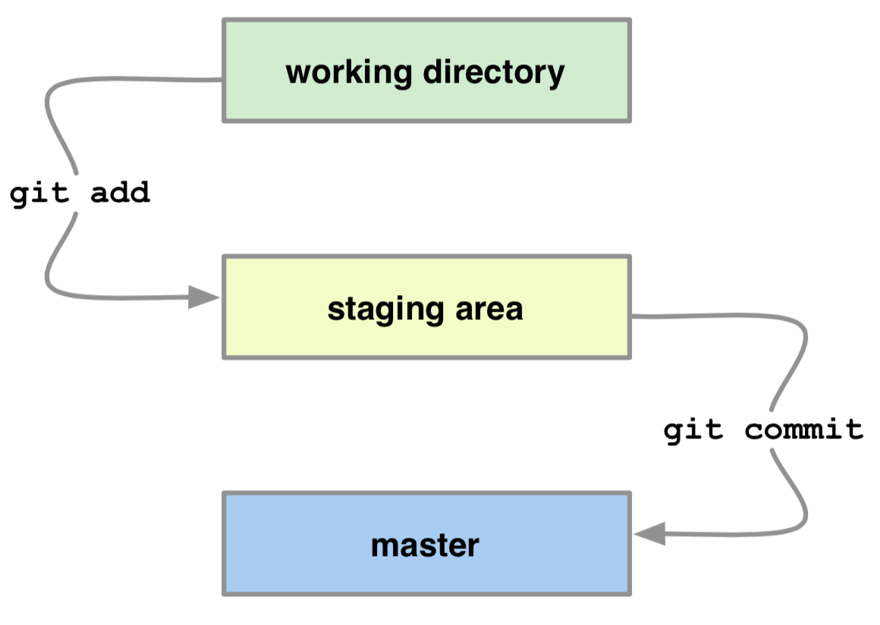
“git add” and “git commit”
git add <filename>
git commit -m "Let us begin."
“A staging area is a location where organisms, people, vehicles, equipment or material are assembled before use”.

Slide 18
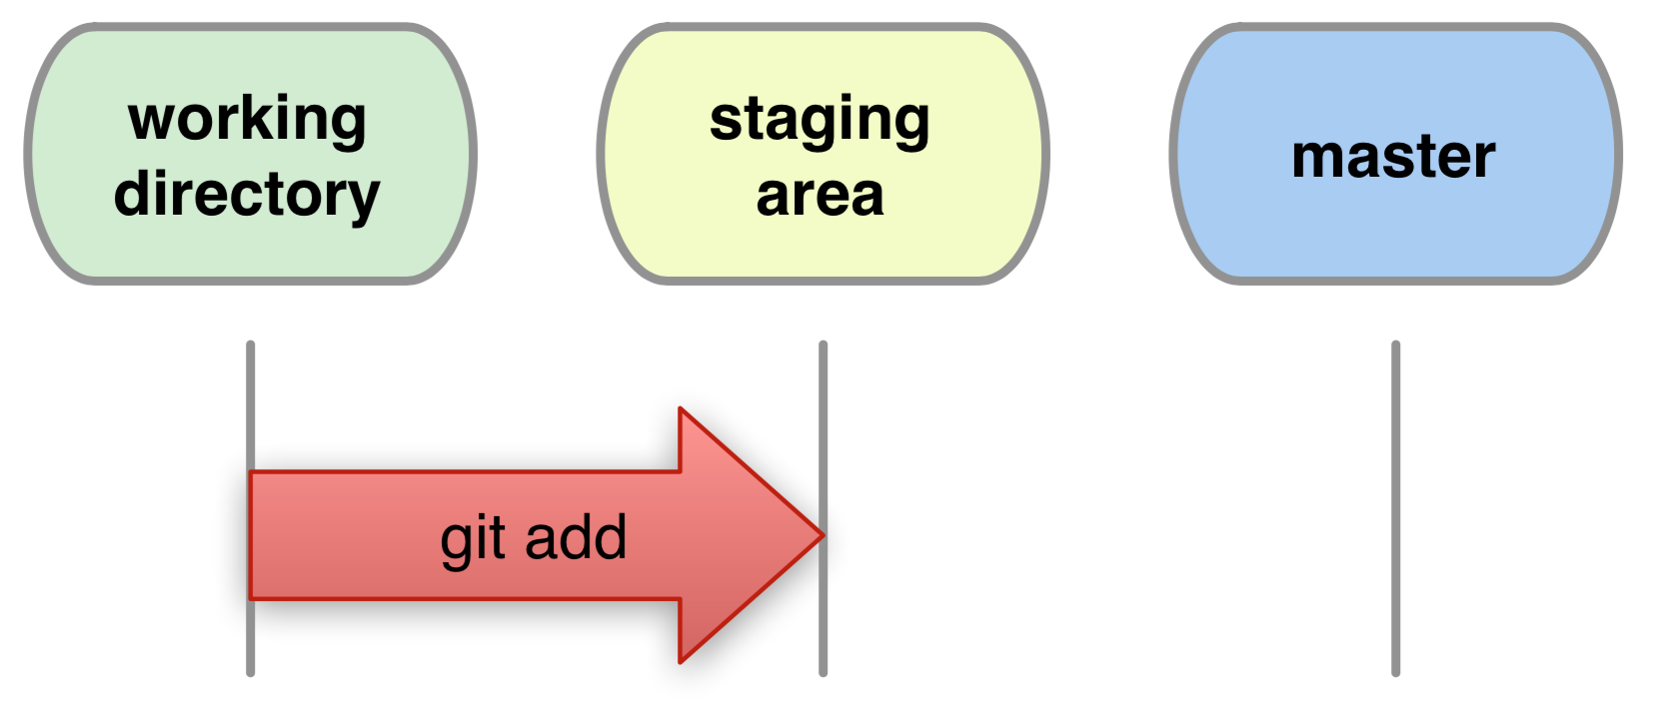
git add (cont’d)
git add file1 [file2 ...]
Adds new files for next commit.
Adds content from working dir to the staging area (index) for next commit.

Slide 19
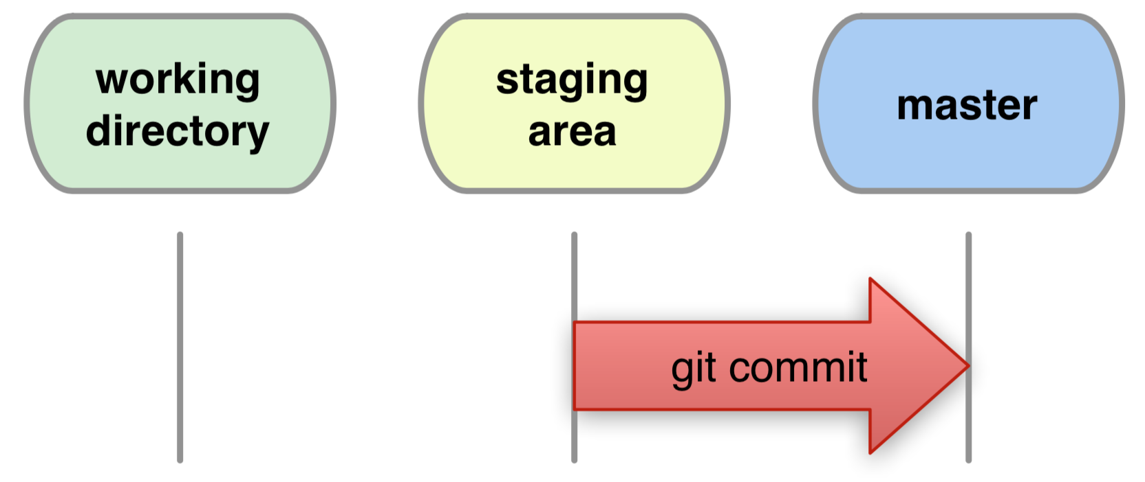
git commit (cont’d)
git commit -m [“Commit message.”]
Records changes from the staging area to master.

Slide 20
git commit (cont’d)
Every commit is a git-object.
The history of a project is a graph of objects referenced by a 40-digit git-name: SHA1(object).

Slide 21
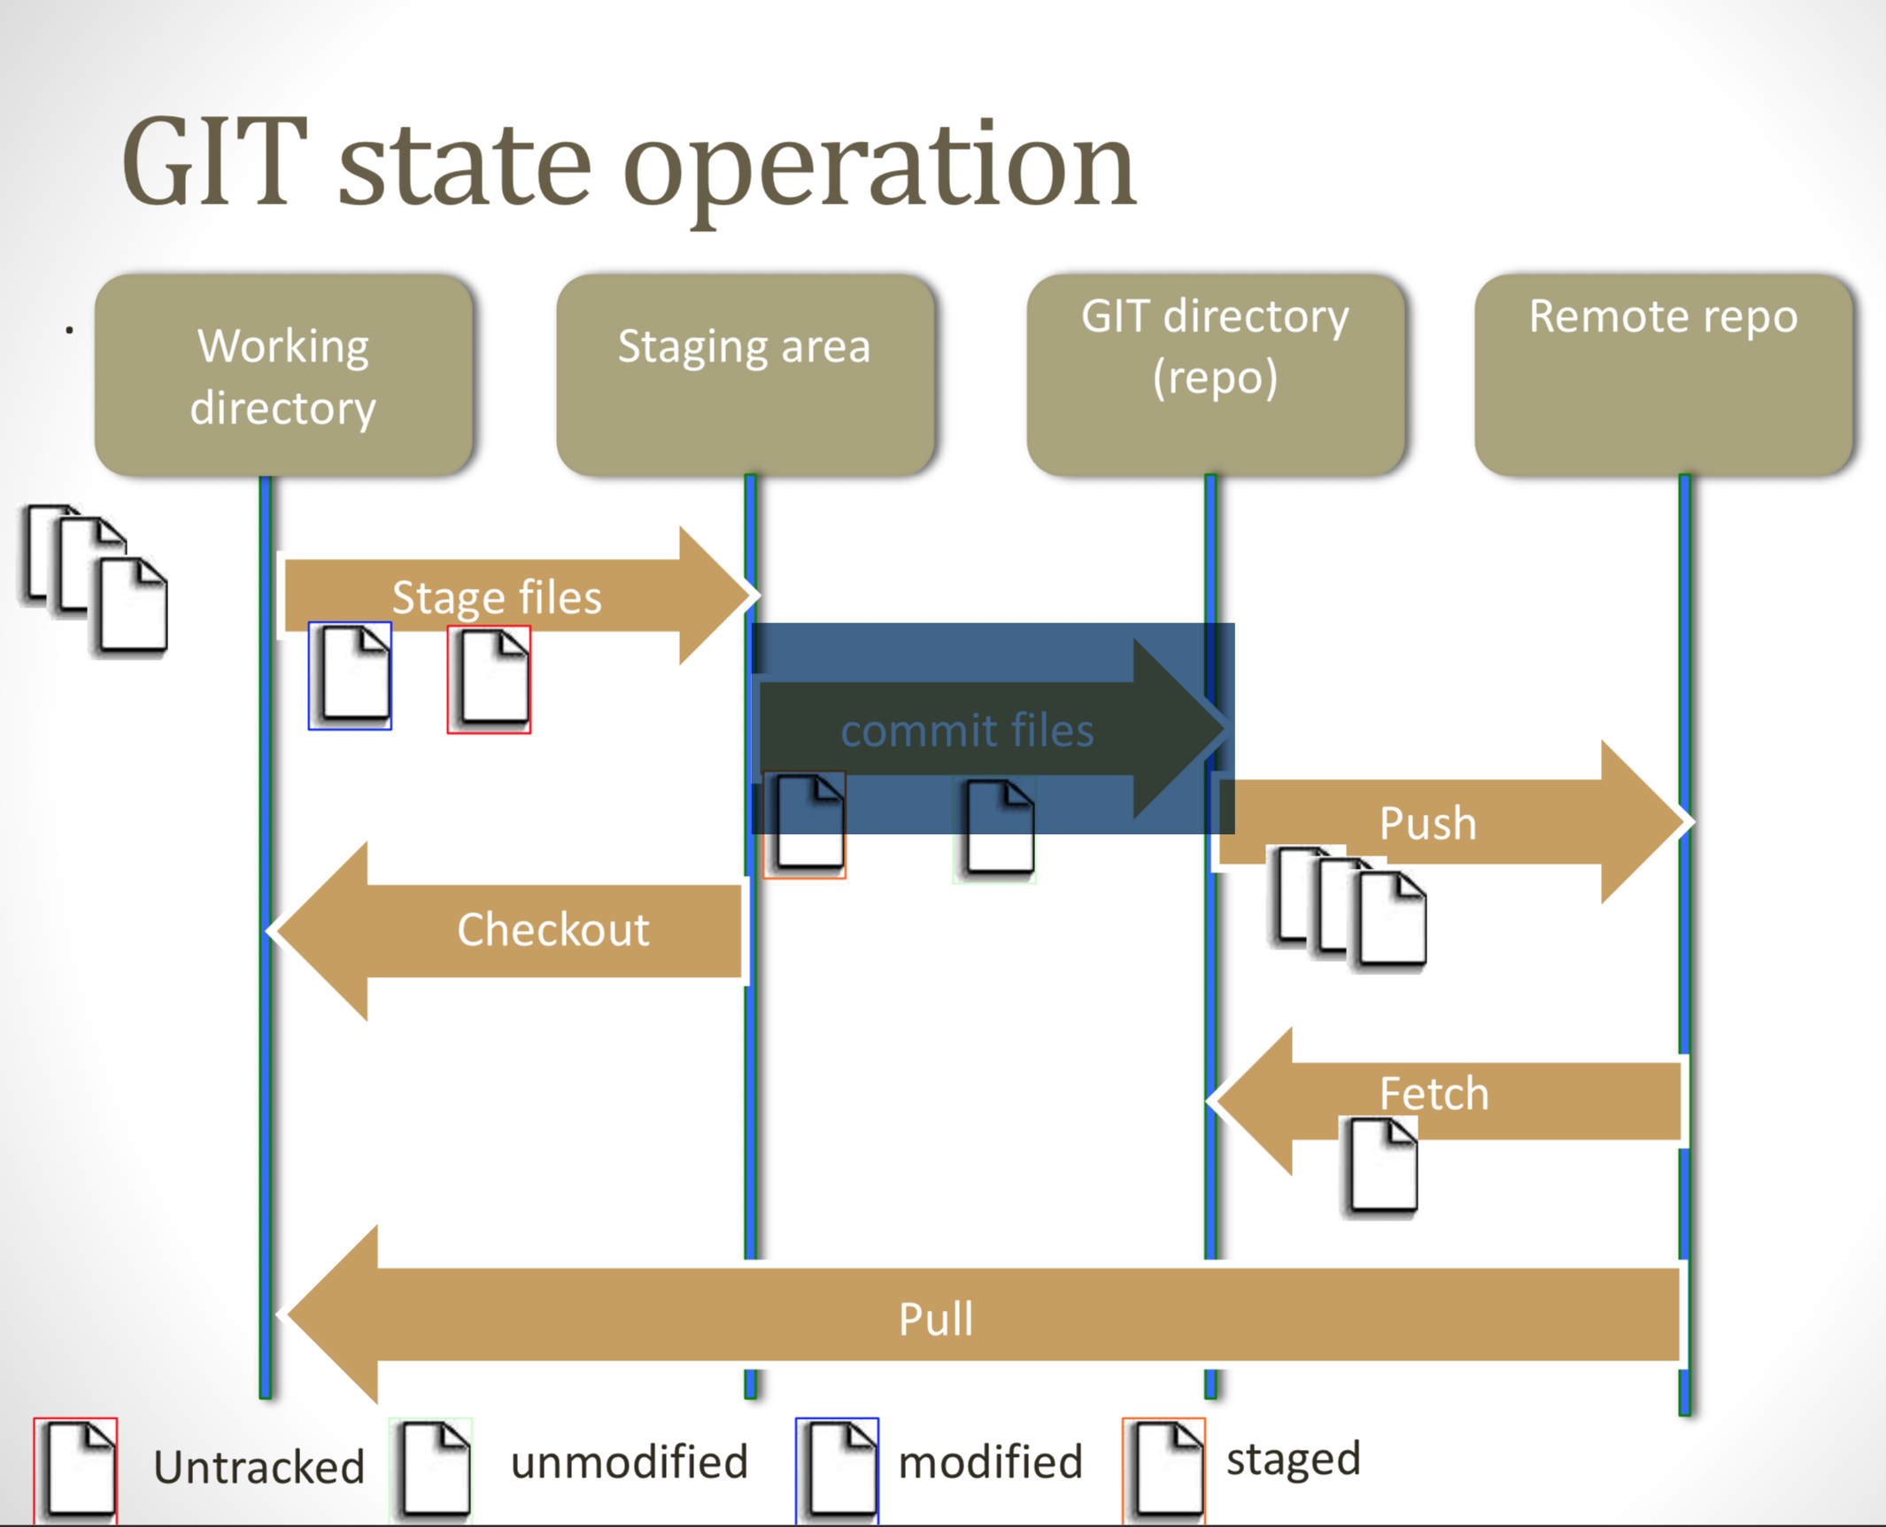
GIT State Operation

Slide 22
Few other common GIT commands

Slide 23
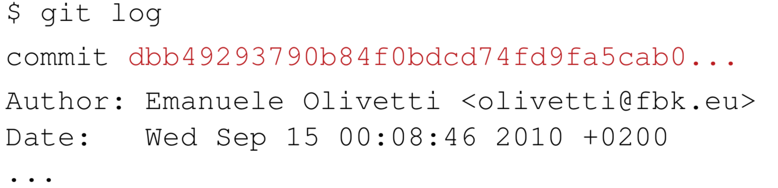
Common GIT commands
git log
Shows details of the commits.
Example:
git status
displays the state of the working directory and the staging area

Slide 24
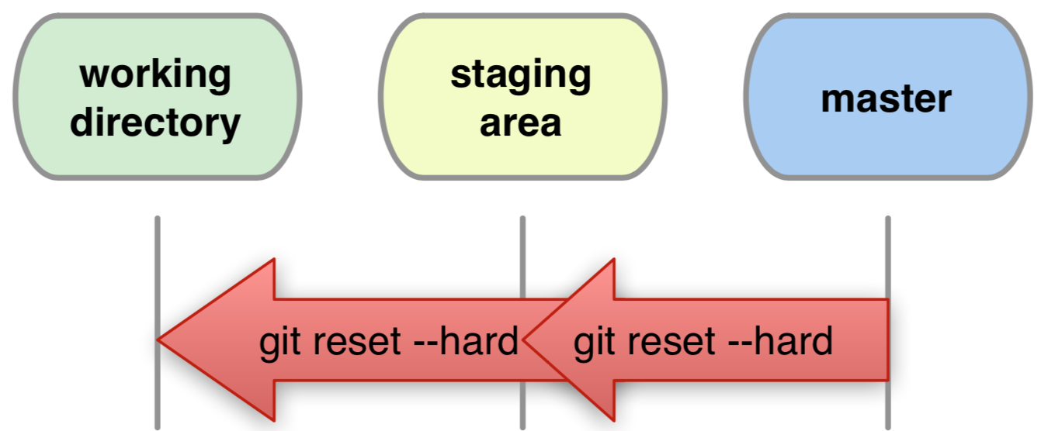
git reset
git reset --hard HEAD
Restore all files as in the last commit.
If a lot of mess and need to clean, then this is THE COMMAND
Will make working directory same as the last commit
**Warning: reset can destroy history!

Slide 25
git remove
Warning: whenever you want to remove, move or rename a tracked file use git
git rm <filename>
git mv <oldname> <newname>
Remember to commit these changes to reflect

Slide 26
GIT with multiple users and remote repository

Slide 27
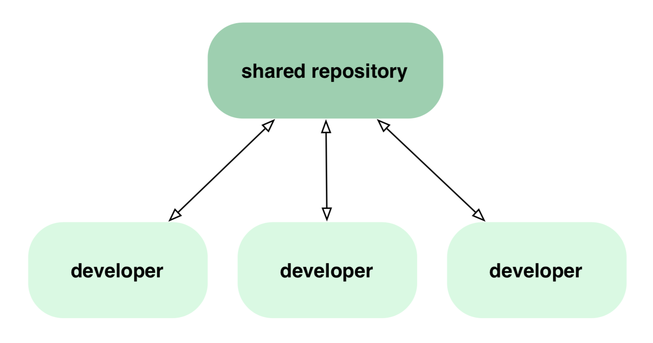
GIT Remote repository

Slide 28
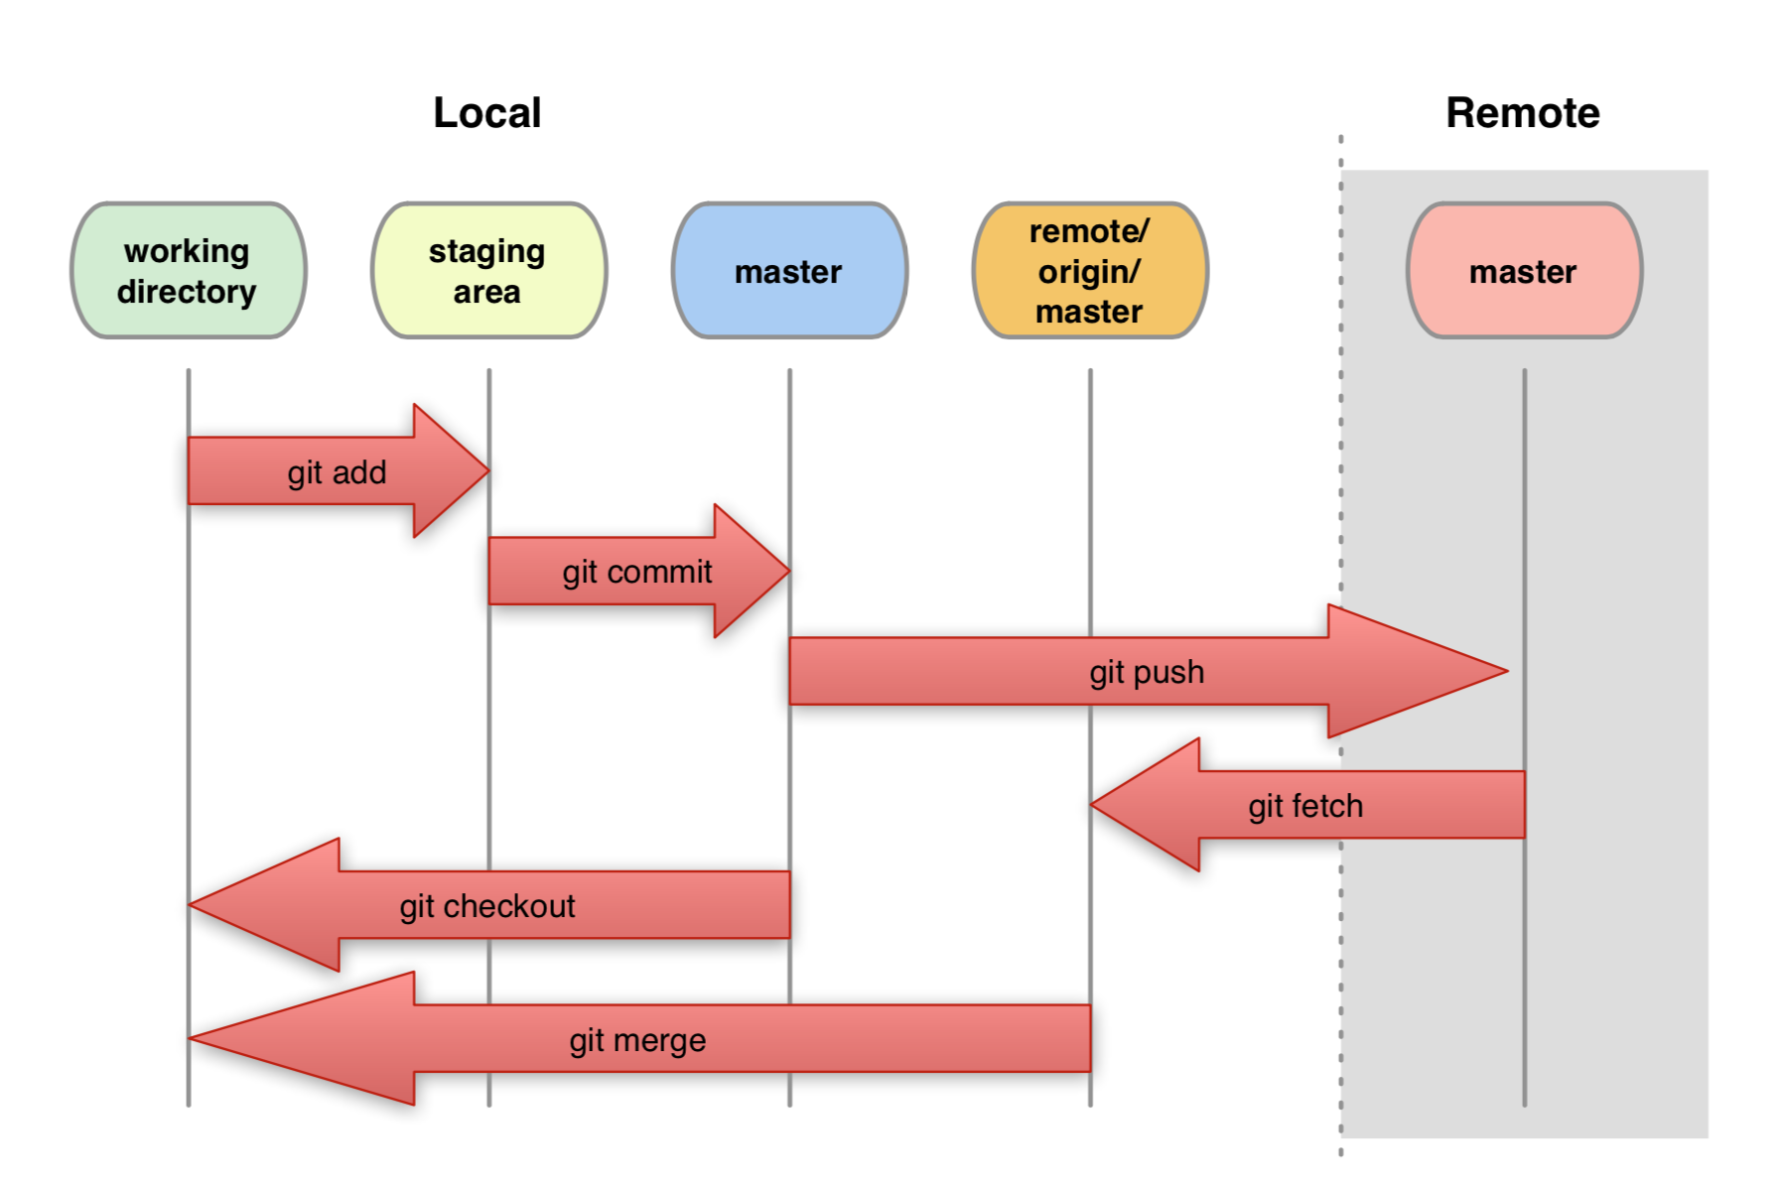
From Local to Remote

Slide 29
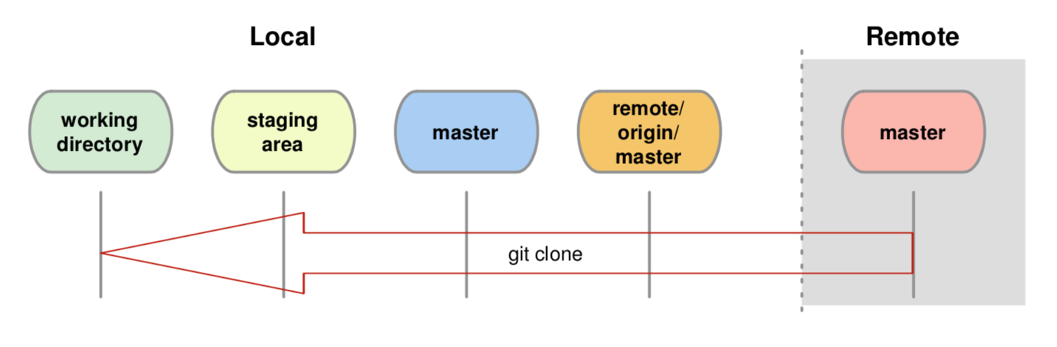
git clone
git clone <url>
Creates two local copies of the whole remote repository.
Ex.: git clone https://github.com/abhi/demo.git
git remote -v
shows name and URL of the remote repository.

Slide 30
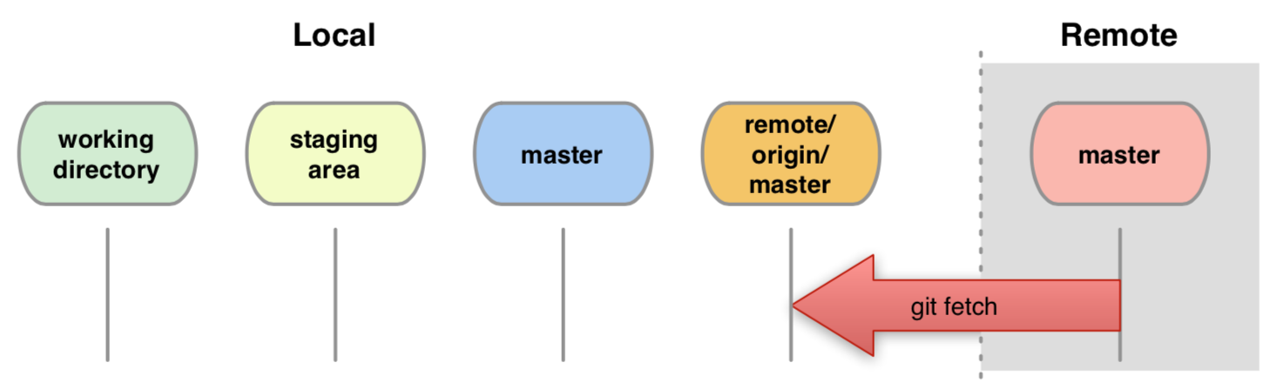
git fetch
Downloads updates from remote master to local remote master.
The local master, staging area and working directory do not change.
Notes:
Why origin?
Origin is just a label. We can change it as and when we like.

Slide 31
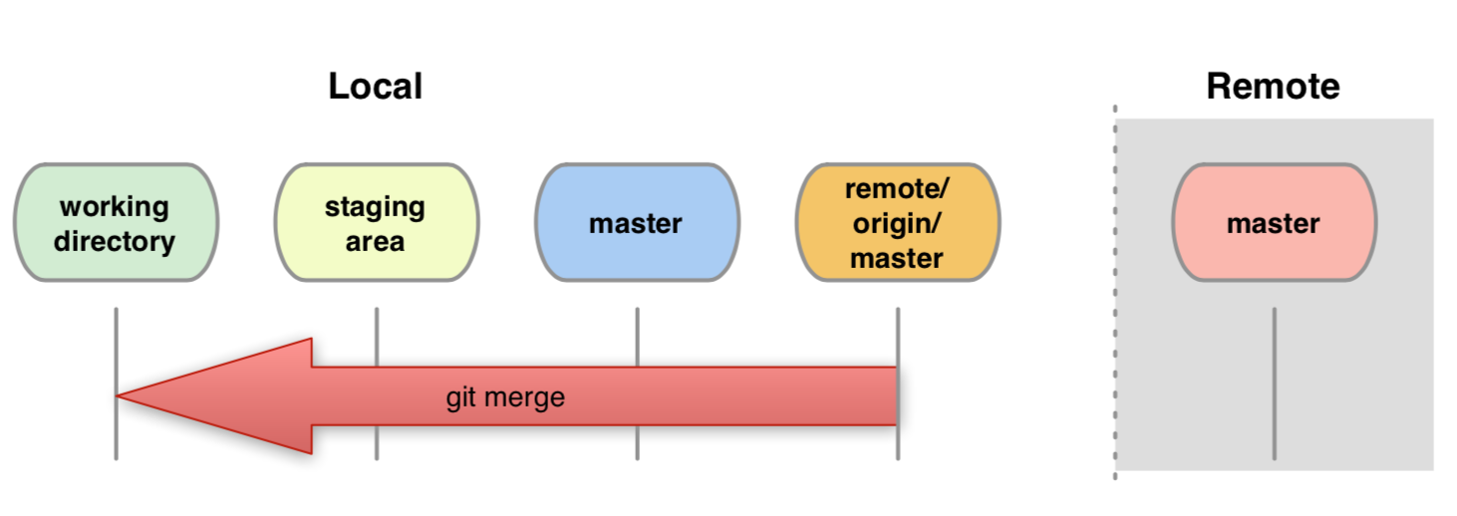
git merge
Joins development histories together.
Warning: can generate conflicts!
Note: it merges only when all changes are committed.
Git fetch and git merge can be combined by using git pull

Slide 32
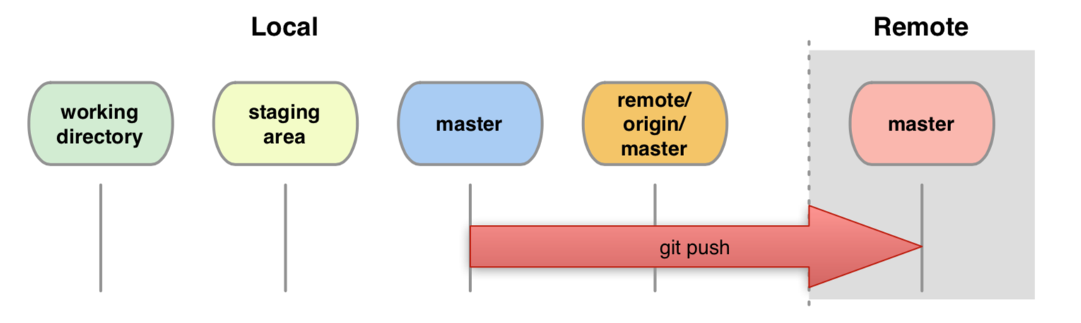
git pull and git push
git pull
Fetch changes from a remote repository into the current branch.
git pull origin <branch name>
git push
Updates remote masters (both Local and Remote).
Requires fetch+merge first (i.e pull).
git push origin <branch name>

Slide 33
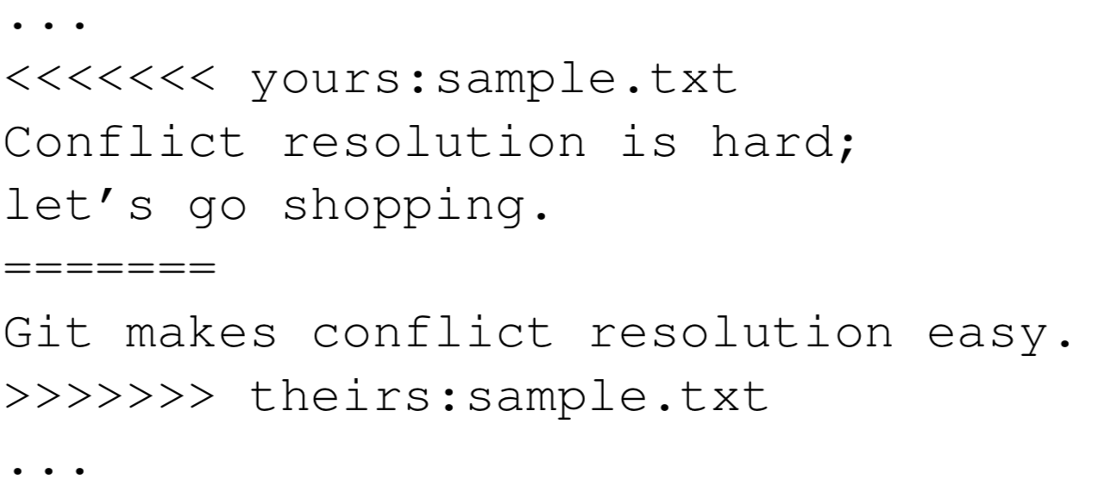
Conflicts
Conflicts occurs when same file changed by multiple users
Or same file changed in a contradictory ways.
It’s a rare scenario when GIT cannot figure out which changes needs to be kept.

Slide 34
Resolve Conflicts
See where conflicts are:
Edit conflicting lines.
Add changes to the staging area: (Using “git add” )
Commit changes: (Using “git commit”)

Slide 35
Branching

Slide 36
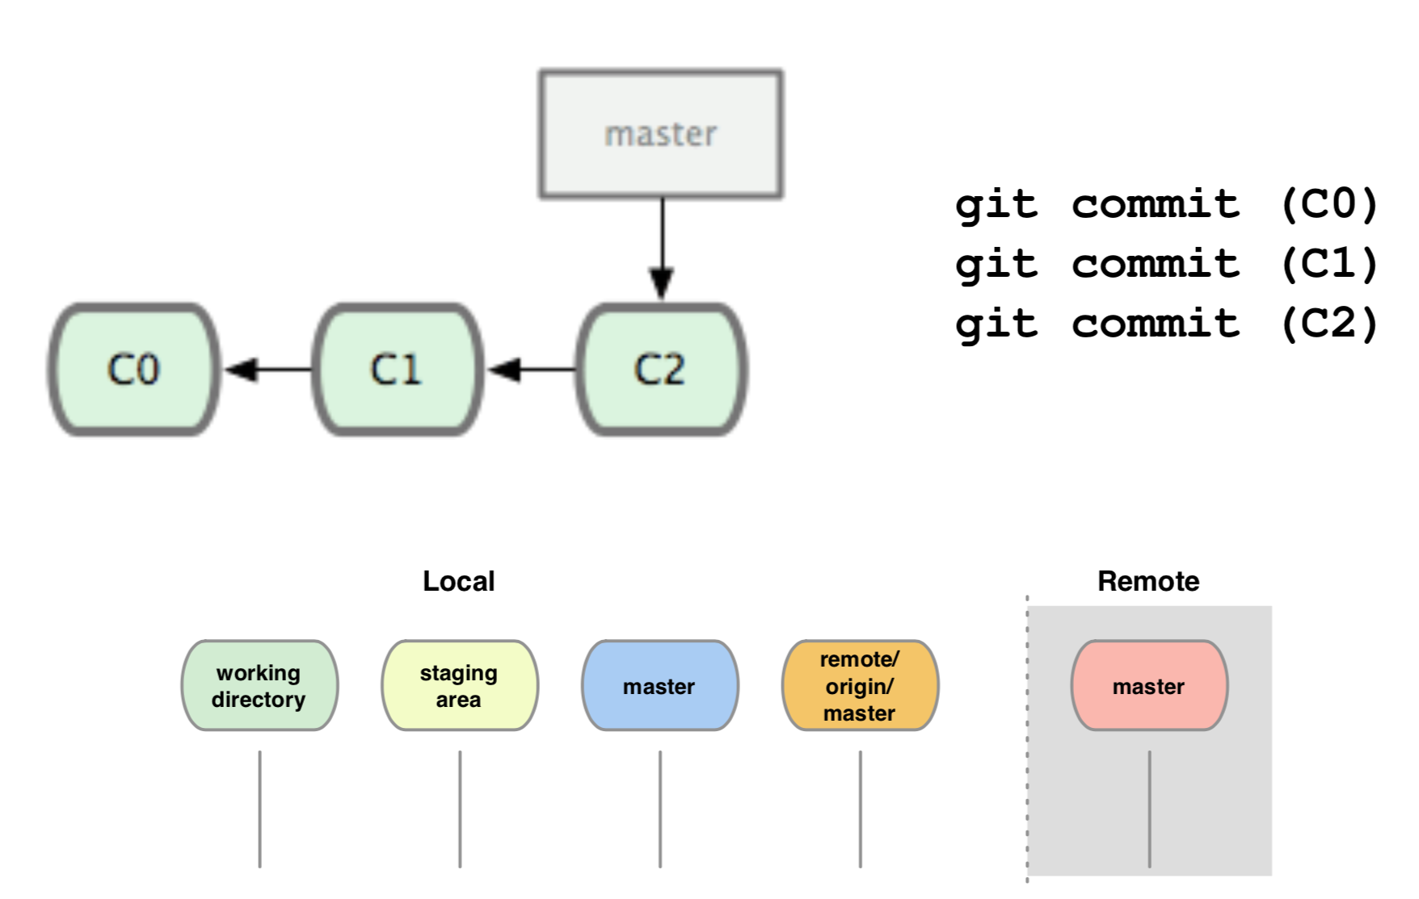
Basic branching

Slide 37
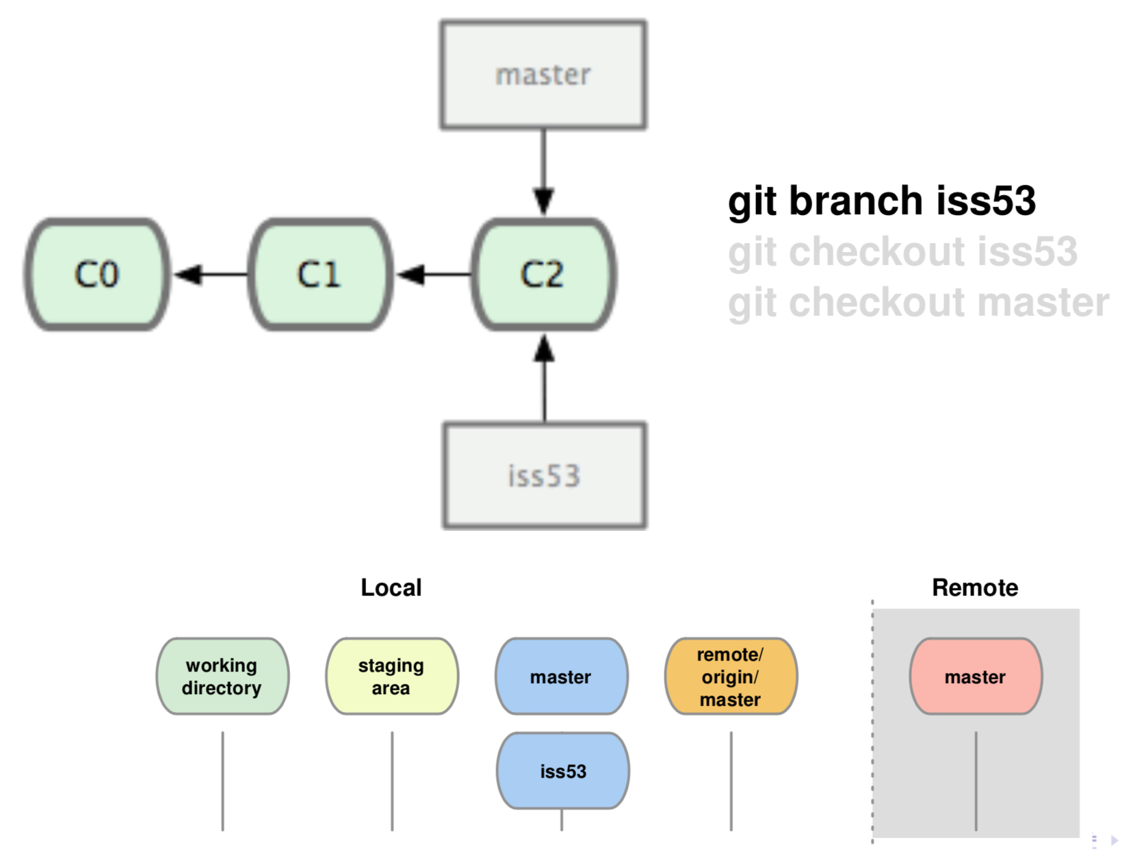
Basic branching

Slide 38
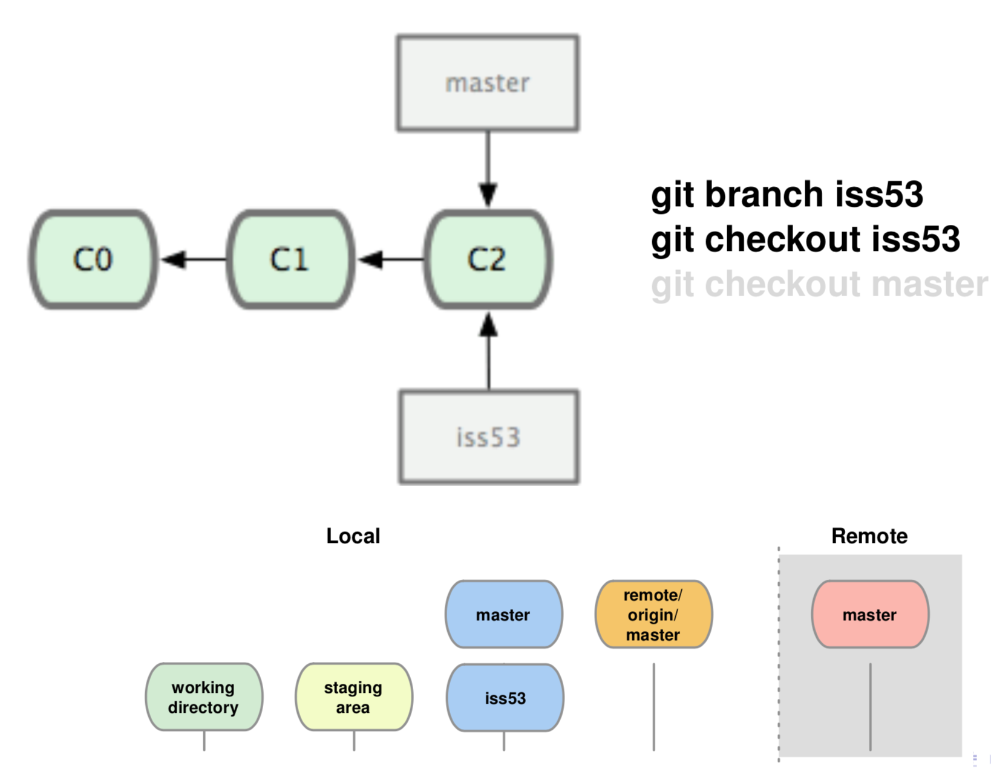
Basic branching

Slide 39
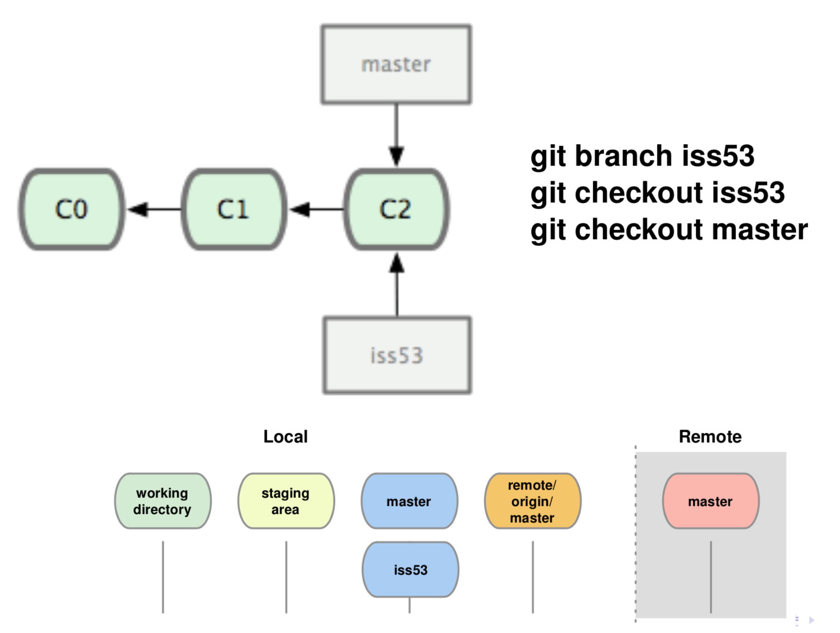
Basic branching

Slide 40
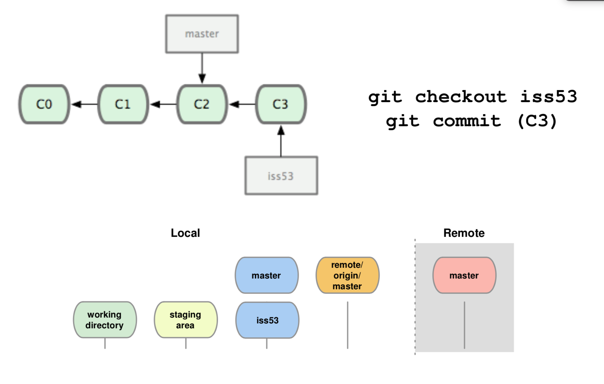
Basic branching

Slide 41
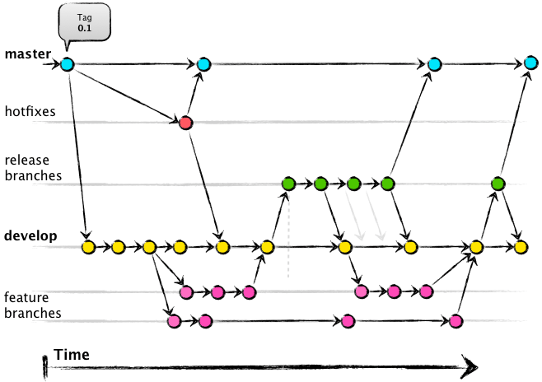
Branching Strategy

Slide 42
.gitignore
A gitignore file specifies intentionally untracked files that Git should ignore.
files and directories both can be added.
Files already tracked by Git are not affected.
It reads file in the same directory as the path
A project normally includes such .gitignore files in its repository, containing patterns for files generated as part of the project build.
https://github.com/github/gitignore

Slide 43
Git tools
Fork
GitKraken
GitTortoise
SmartGit
SourceTree

Slide 44
Popular GIT Servers
GitHub
Bitbucket
GitLab
AWS CodeCommit
Meat

Slide 45
Questions?

Slide 46
Thank You

